Slide 1
10707 Deep Learning: Spring 2021
Andrej Risteski
Machine Learning Department
Lecture 4: Convolutional architectures

Slide 2
Used Resources
Disclaimer: Some material in this lecture was borrowed from: Hugo Larochelle’s class on Neural Networks:
https://sites.google.com/site/deeplearningsummerschool2016/
Rob Fergus’ CIFAR/MLSS tutorial on ConvNets:
http://mlss.tuebingen.mpg.de/2015/slides/fergus/Fergus_1.pdf
Marc'Aurelio Ranzato’s CVPR 2014 tutorial on Convolutional Nets
https://sites.google.com/site/lsvrtutorialcvpr14/home/deeplearning

Slide 3
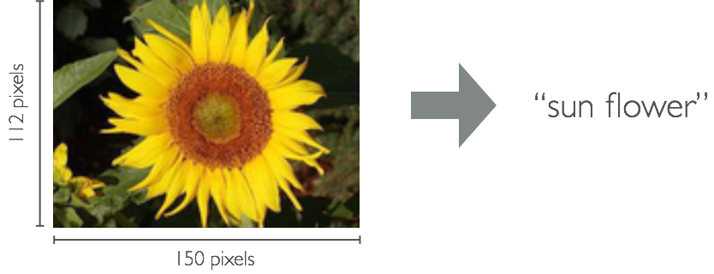
Neural networks for vision
Prototypical task in vision is object recognition: given an input image, identify what kind of object it contains.
Are feedforward networks the right architecture for this?

Slide 4
Desiderata for networks for vision
Inputs are very high-dimensional: 150 x 150 pixels = 22500 inputs, or 3 x 22500 if RGB pixels instead of grayscale.
Should leverage the spatial locality (in the pixel sense) of data
Build in invariance to natural variations: translation, illumination, etc.
Convolutional architectures are designed for this:
Local connectivity (reflects spatial locality and decreases # params)
Parameter sharing (further decreases # params)
Convolution
Pooling / subsampling hidden units

Slide 5
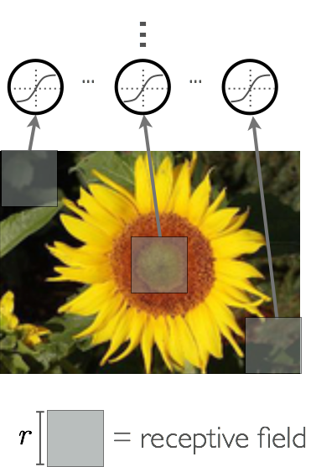
Local Connectivity
Use local connectivity of hidden units
Each hidden unit is connected only to a sub-region (patch) of the input image. It is connected to all channels: 1 if grayscale, 3 (R, G, B) if color image
Why this is a good idea:
Fully connected layer has a lot of parameters to fit, which requires a lot of training data
Image data isn’t arbitrary: neighboring pixels are “meaningfully related” – e.g. if a node is to be a “dog nose” detector – need to look at small patch of pixels.

Slide 6
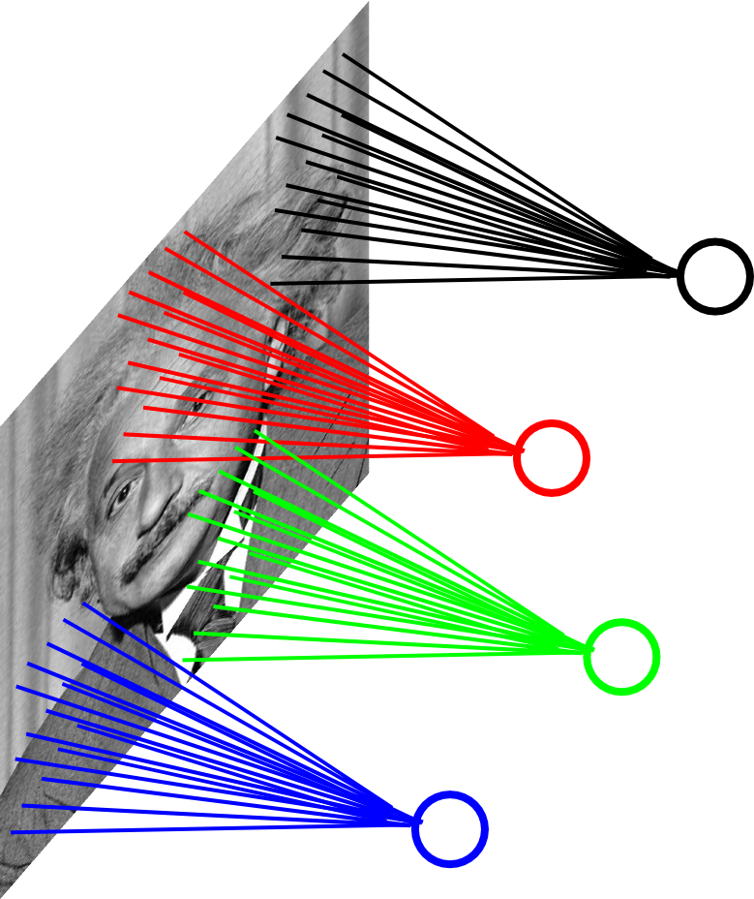
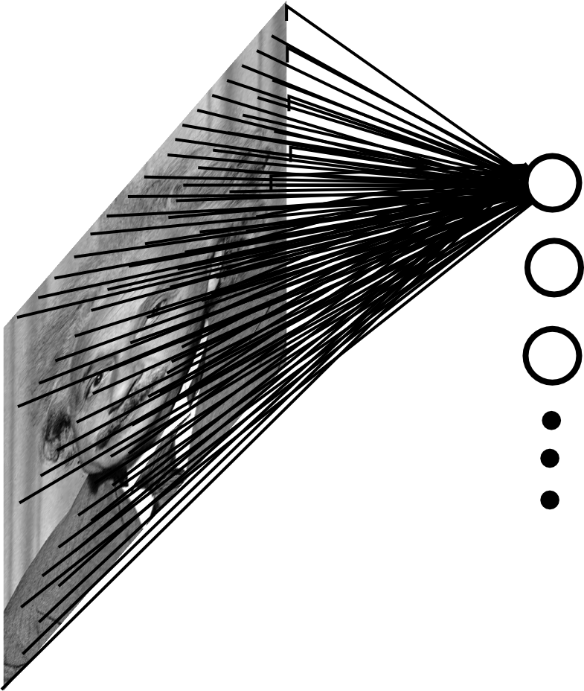
Decrease in # of parameters
Convolutional: 200x200 image, 40K hidden units, window size 10x10, ~4M parameters!
Fully connected: 200x200 image, 40K hidden units, ~2B parameters!

Slide 7

Parameter Sharing
Prior approach makes weights sensitive to translations: e.g.
Might learn weights for nose detector here
But not learn weights for a nose detector here

Slide 8
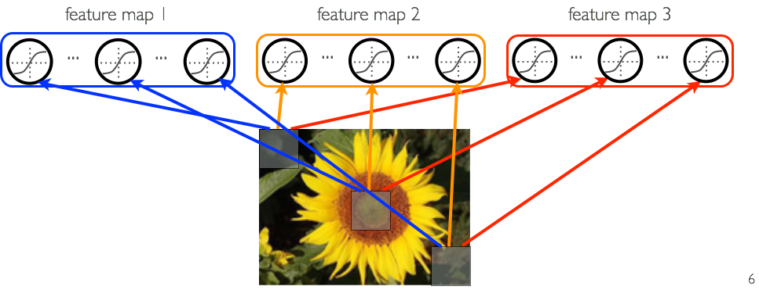
Parameter Sharing
Share matrix of parameters across some units
Units that are organized into the “feature map” share parameters
Hidden units within a feature map cover different positions in the image
same color
=
same matrix of connection
W_{ij} is the matrix connecting the i^{th} input channel with the j^{th} feature map

Slide 9
Desiderata for networks for vision
Our goal is to design neural networks that are specifically adapted for such problems
Must deal with very high-dimensional inputs: 150 x 150 pixels = 22500 inputs, or 3 x 22500 if RGB pixels
Can exploit the 2D topology of pixels (or 3D for video data)
Can build in invariance to certain variations: translation, illumination, etc.
Convolutional networks leverage these ideas
Local connectivity
Parameter sharing
Convolution
Pooling / subsampling hidden units

Slide 10
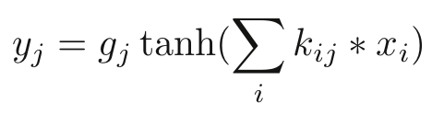
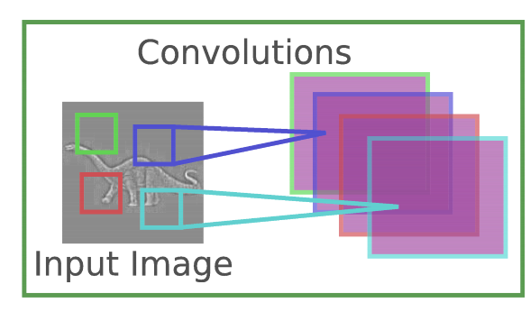

Discrete Convolution
Each feature map forms a 2D grid of features
Can be computed with a discrete convolution ( ) of a kernel matrix k_{ij}
x_{i} is the i^{th} channel of input
k_{ij} is the convolution kernel
g_{j} is a learned scaling factor
y_{j} is the hidden layer
Can add bias
Jarret et al. 2009

Slide 11
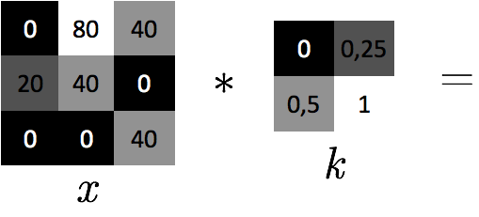
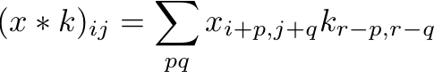
Discrete Convolution
The convolution of an image x with a kernel k is computed as follows:
Example:

Slide 12

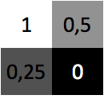
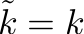
Discrete Convolution
The convolution of an image x with a kernel k is computed as follows:
Example:
with rows and columns flipped

Slide 13
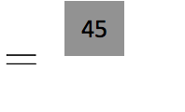
Discrete Convolution
The convolution of an image x with a kernel k is computed as follows:
Example:
1 x 0 + 0.5 x 80 + 0.25 x 20 + 0 x 40 = 45

Slide 14
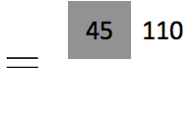
Discrete Convolution
The convolution of an image x with a kernel k is computed as follows:
Example:
1 x 80 + 0.5 x 40 + 0.25 x 40 + 0 x 0 = 110

Slide 15
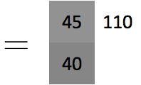
Discrete Convolution
The convolution of an image x with a kernel k is computed as follows:
Example:
1 x 20 + 0.5 x 40 + 0.25 x 0 + 0 x 0 = 40

Slide 16
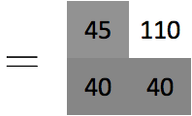
Discrete Convolution
The convolution of an image x with a kernel k is computed as follows:
Example:
1 x 40 + 0.5 x 0 + 0.25 x 0 + 0 x 40 = 40

Slide 17
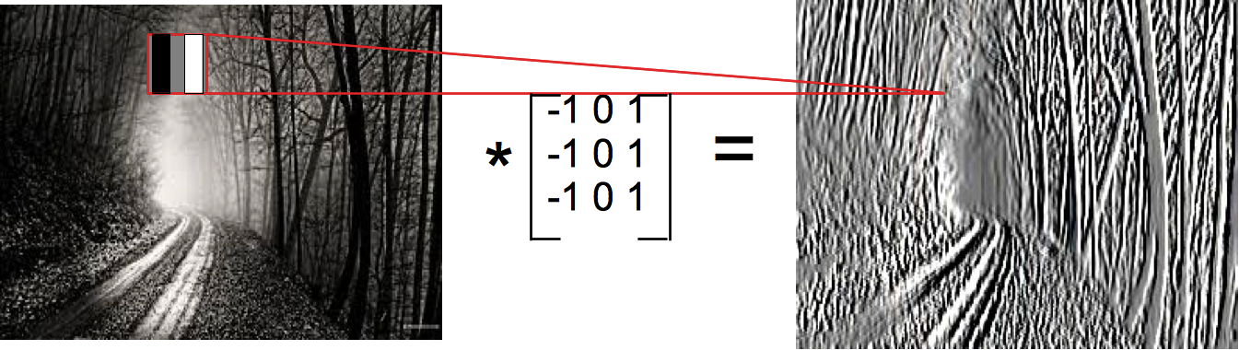
Example of a convolution

Slide 18
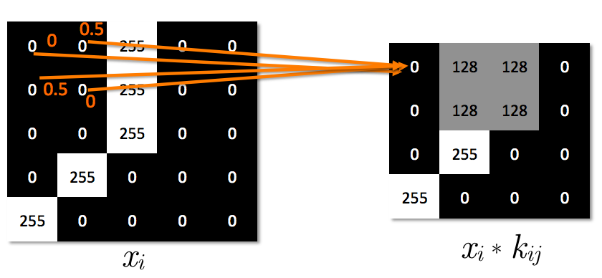
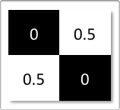
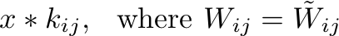
Adding non-linearity
With a non-linearity, we get a detector of a feature at any position in the image:

Slide 19
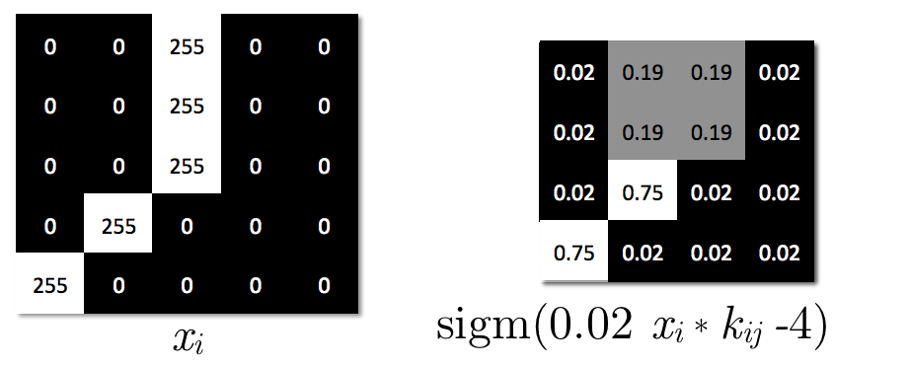
Adding non-linearity
With a non-linearity, we get a detector of a feature at any position in the image:

Slide 20
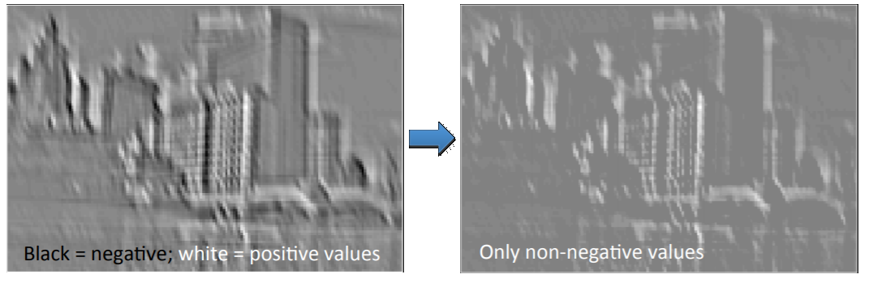
Example of ReLU non-linearity
From Rob Fergus tutorial (http://mlss.tuebingen.mpg.de/2015/slides/fergus/Fergus_1.pdf)

Slide 21
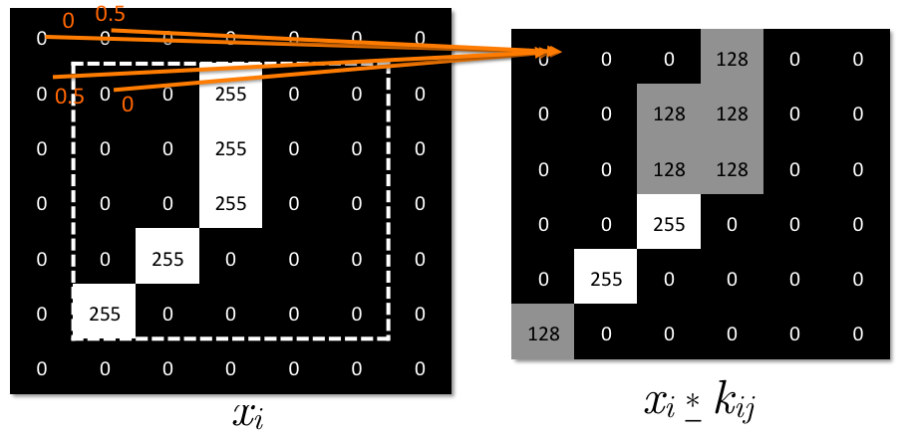
Padding
Can use ‘‘zero padding’’ to allow going over the borders

Slide 22
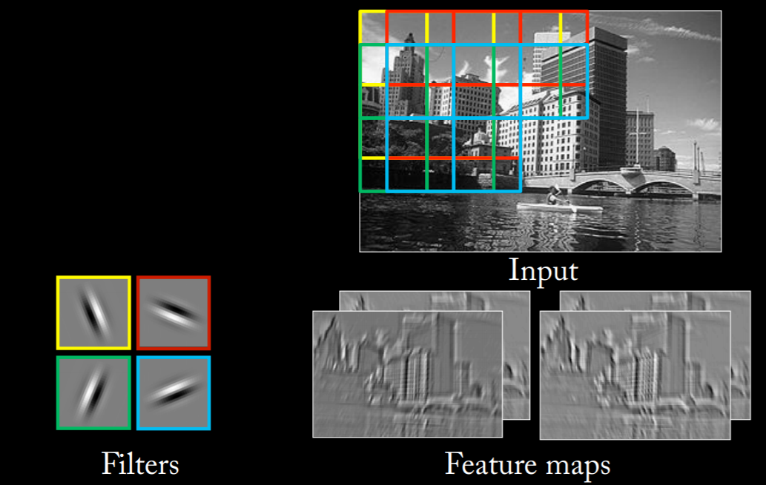
The picture so far
From Rob Fergus tutorial (http://mlss.tuebingen.mpg.de/2015/slides/fergus/Fergus_1.pdf)

Slide 23
Desiderata for networks for vision
Our goal is to design neural networks that are specifically adapted for such problems
Must deal with very high-dimensional inputs: 150 x 150 pixels = 22500 inputs, or 3 x 22500 if RGB pixels
Can exploit the 2D topology of pixels (or 3D for video data)
Can build in invariance to certain variations: translation, illumination, etc.
Convolutional networks leverage these ideas
Local connectivity
Parameter sharing
Convolution
Pooling / subsampling hidden units

Slide 24
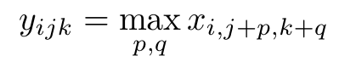
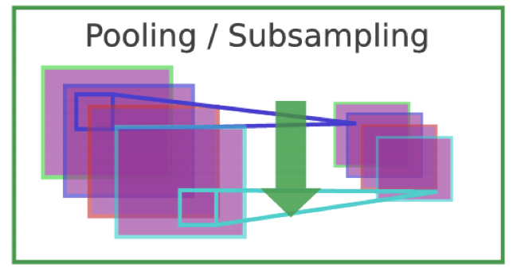
Pooling
Pool hidden units in same neighborhood
Pooling is performed in non-overlapping neighborhoods (subsampling)
x_{i} is the i^{th} channel of input
x_{i,j,k} is value of the i^{th} feature map at position j,k
p is vertical index in local neighborhood
q is horizontal index in local neighborhood
y_{ijk} is pooled / subsampled layer
Jarret et al. 2009

Slide 25
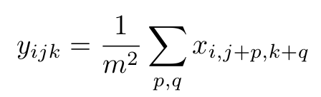
Pooling
Pool hidden units in same neighborhood
An alternative to ‘‘max’’ pooling is ‘‘average’’ pooling
x_{i} is the i^{th} channel of input
x_{i,j,k} is value of the i^{th} feature map at position j,k
p is vertical index in local neighborhood
q is horizontal index in local neighborhood
y_{ijk} is pooled / subsampled layer
m is the neighborhood height/width
Jarret et al. 2009

Slide 26
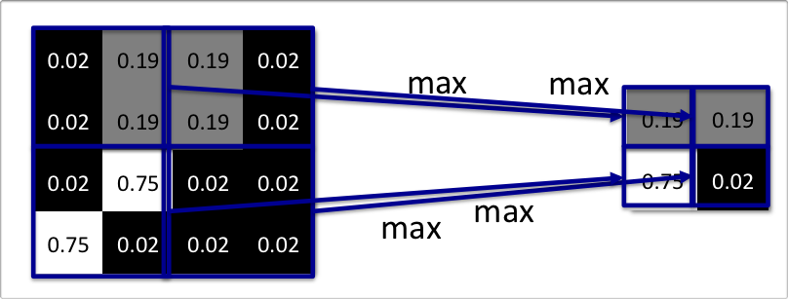
Example: Pooling
Illustration of pooling/subsampling operation
Why pooling?
Introduces invariance to local translations
Reduces the number of hidden units in hidden layer

Slide 27
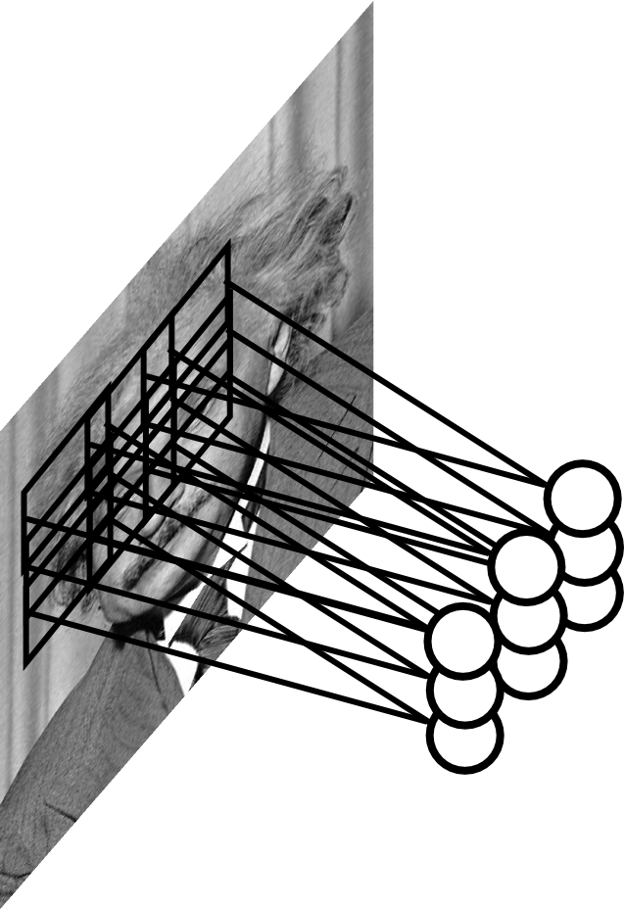
Example: Pooling
Can we make the detection robust to the exact location of the eye?

Slide 28
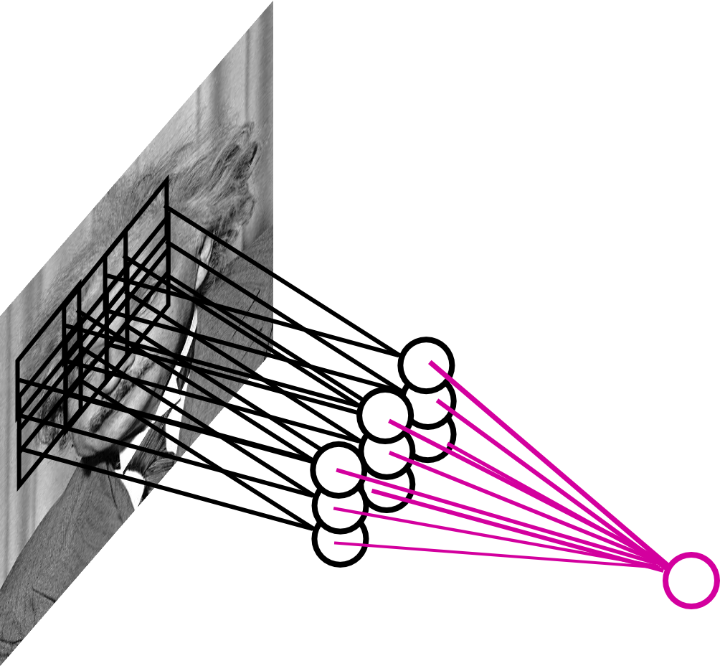
Example: Pooling
By “pooling” (e.g., taking max) filter responses at different locations we gain robustness to the exact spatial location of features.

Slide 29
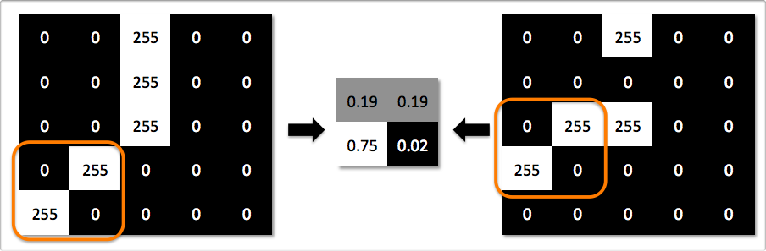
Translation Invariance
Illustration of local translation invariance
Both images result in the same feature map after pooling/subsampling

Slide 30
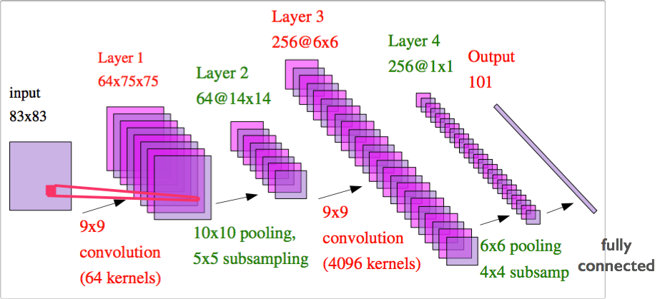
Convolutional Network
Convolutional neural network alternates between convolutional and pooling layers
From Yann LeCun’s slides

Slide 31
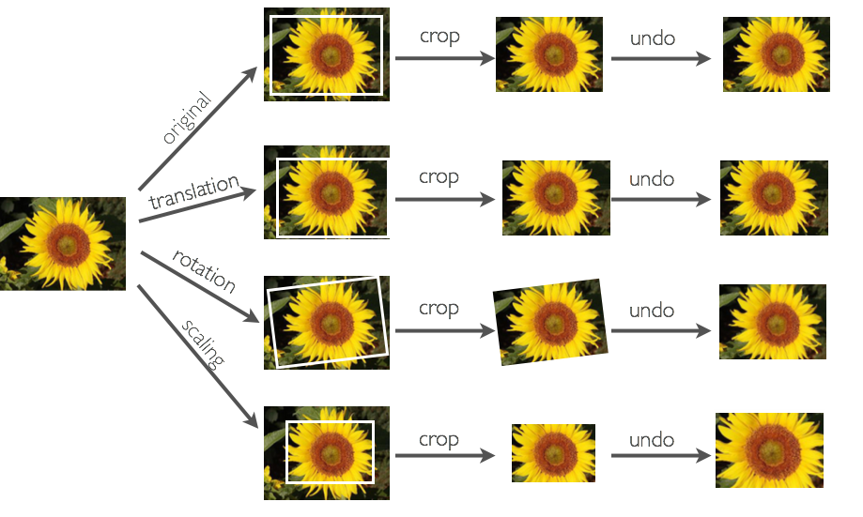
Generating Additional Examples

Slide 32
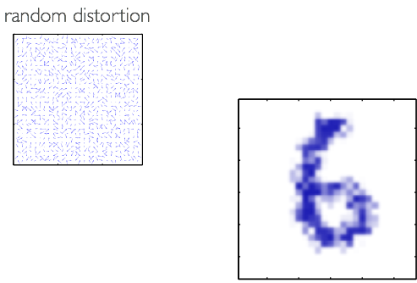
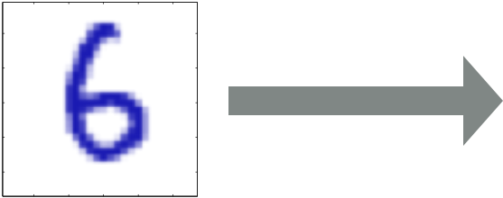
Elastic Distortions
Can add ‘‘elastic’’ deformations (useful in character recognition)
We can do this by applying a ‘‘distortion field’’ to the image
A distortion field specifies where to displace each pixel value
Bishop’s book

Slide 33
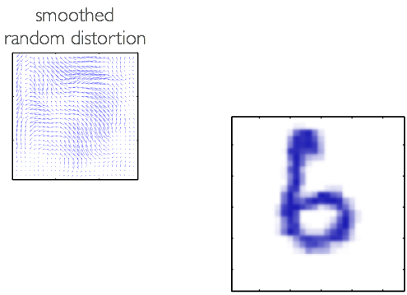
Elastic Distortions
Can add ‘‘elastic’’ deformations (useful in character recognition)
We can do this by applying a ‘‘distortion field’’ to the image
A distortion field specifies where to displace each pixel value
Bishop’s book

Slide 34
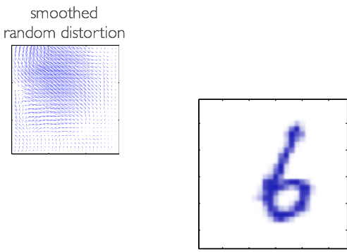
Elastic Distortions
Can add ‘‘elastic’’ deformations (useful in character recognition)
We can do this by applying a ‘‘distortion field’’ to the image
A distortion field specifies where to displace each pixel value
Bishop’s book

Slide 35
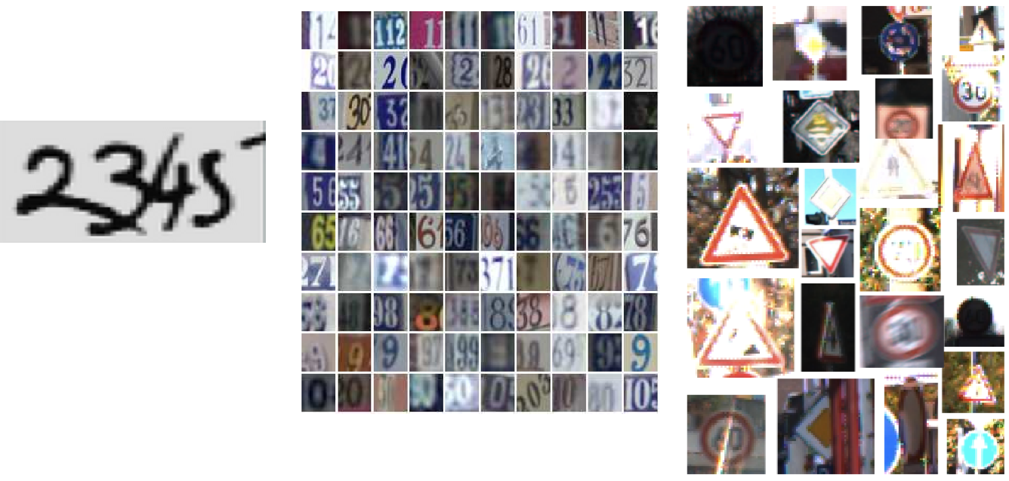
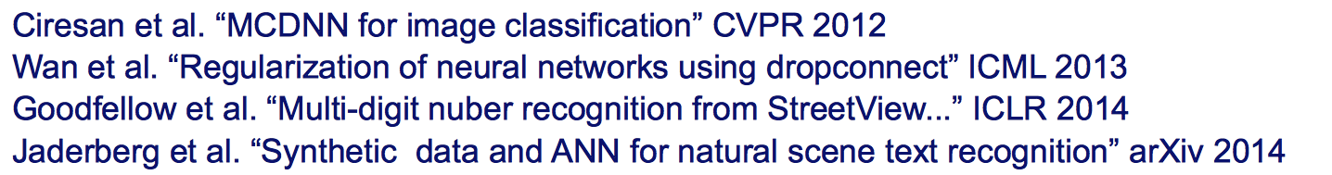
Conv Nets: Examples
Optical Character Recognition, House Number and Traffic Sign classification

Slide 36
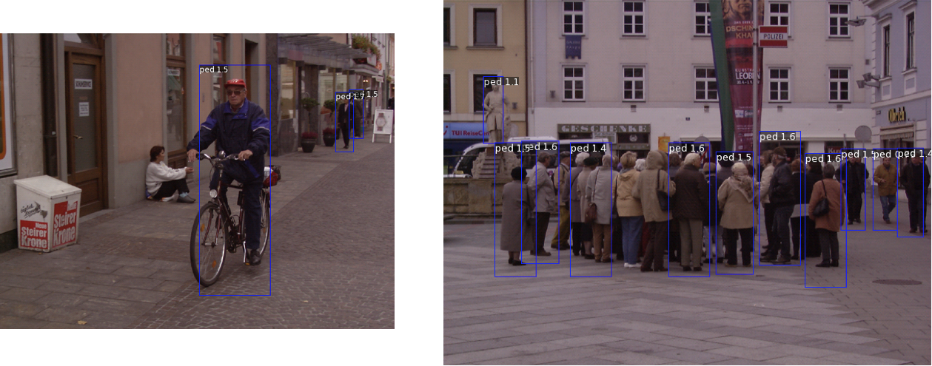
Conv Nets: Examples
Pedestrian detection
Sermanet et al. “Pedestrian detection with unsupervised multi-stage..” CVPR 2013

Slide 37
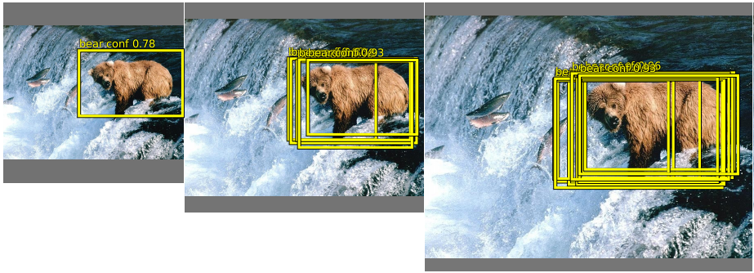
Conv Nets: Examples
Object Detection
Sermanet et al. “OverFeat: Integrated recognition, localization” arxiv 2013
Girshick et al. “Rich feature hierarchies for accurate object detection” arxiv 2013
Szegedy et al. “DNN for object detection” NIPS 2013

Slide 38

ImageNet Dataset
~14 million images, 20k classes
Examples of “Hammer”
Deng et al. “Imagenet: a large scale hierarchical image database” CVPR 2009

Slide 39
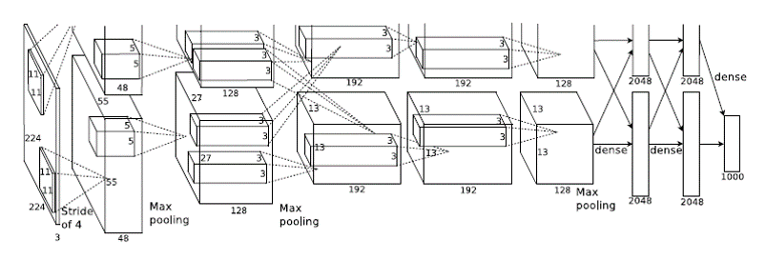
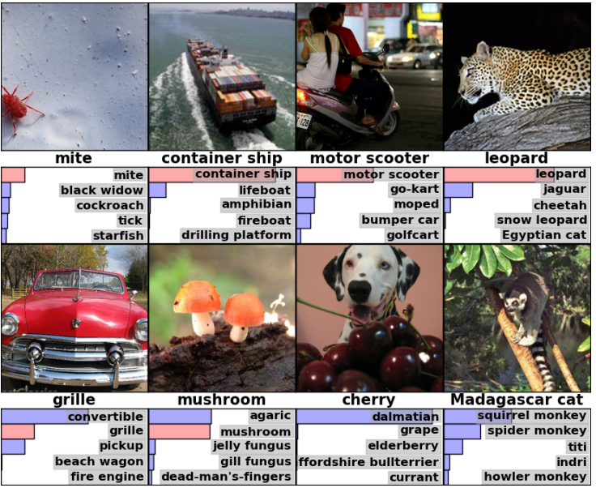
Important Breakthroughs
Deep Convolutional Nets for Vision (Supervised)
Krizhevsky, A., Sutskever, I. and Hinton, G. E., ImageNet Classification with Deep Convolutional Neural Networks, NIPS, 2012.
~14 million images, 20k classes

Slide 40
Architecture
How can we select the “right” architecture:
Manual tuning of features is now replaced with the manual tuning of architectures
Depth
Width
Parameter count

Slide 41
How to Choose Architecture
Many hyper-parameters:
Number of layers, number of feature maps
Cross Validation
Grid Search (need lots of GPUs)
Smarter Strategies
Random search [Bergstra & Bengio JMLR 2012]
Bayesian Optimization

Slide 42
Famous architectures

Slide 43
AlexNet
Softmax Output
8 layers total, ~60 million parameters
Trained on Imagenet dataset [Deng et al. CVPR’09]
18.2% top-5 error
Layer 7: Full
Layer 6: Full
Layer 5: Conv + Pool
Layer 4: Conv
Layer 3: Conv
Layer 2: Conv + Pool
Layer 1: Conv + Pool
Input Image
[From Rob Fergus’ CIFAR 2016 tutorial]

Slide 44
AlexNet: ablation study
Softmax Output
Remove top fully connected layer 7
Drop ~16 million parameters
Only 1.1% drop in performance!
Layer 6: Full
Layer 5: Conv + Pool
Layer 4: Conv
Layer 3: Conv
Layer 2: Conv + Pool
Layer 1: Conv + Pool
Input Image
[From Rob Fergus’ CIFAR 2016 tutorial]

Slide 45
AlexNet: ablation study
Softmax Output
Remove both fully connected layers 6,7
Drop ~50 million parameters
5.7% drop in performance!
Layer 5: Conv + Pool
Layer 4: Conv
Layer 3: Conv
Layer 2: Conv + Pool
Layer 1: Conv + Pool
Input Image
[From Rob Fergus’ CIFAR 2016 tutorial]

Slide 46
AlexNet: ablation study
Softmax Output
Remove upper feature extractor layers (Layers 3 & 4)
Drop ~1 million parameters
3% drop in performance.
Layer 7: Full
Layer 6: Full
Layer 5: Conv + Pool
Layer 2: Conv + Pool
Layer 1: Conv + Pool
Input Image
[From Rob Fergus’ CIFAR 2016 tutorial]

Slide 47
AlexNet: ablation study
Let us remove upper feature extractor layers and fully connected:
33.5% drop in performance!
Depth of the network is the key.
Softmax Output
Layers 3,4, 6 and 7
Layer 5: Conv + Pool
Layer 2: Conv + Pool
Layer 1: Conv + Pool
Input Image
[From Rob Fergus’ CIFAR 2016 tutorial]

Slide 48
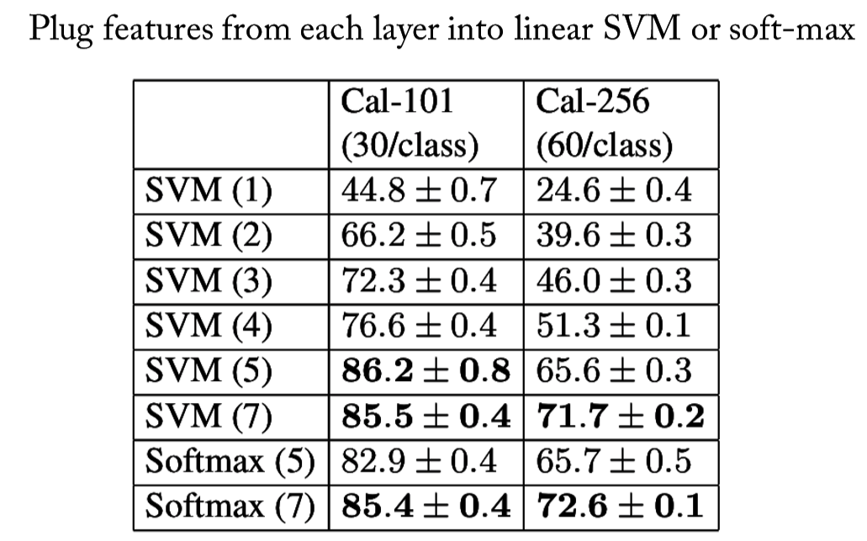
AlexNet: intermediate features
[From Rob Fergus’ CIFAR 2016 tutorial]

Slide 49
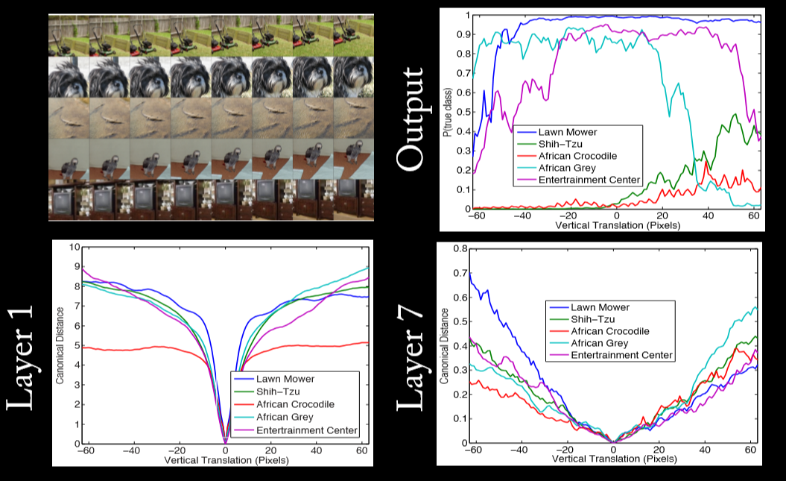
AlexNet: translation invariance
[From Rob Fergus’ CIFAR 2016 tutorial]

Slide 50
AlexNet: translation invariance
[From Rob Fergus’ CIFAR 2016 tutorial]

Slide 51
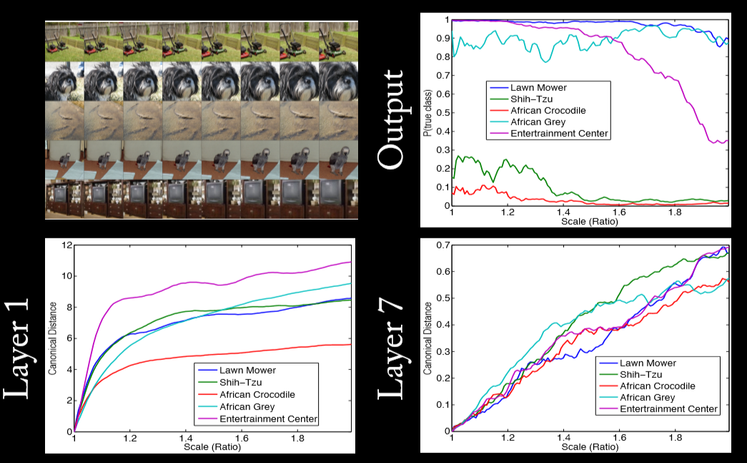
AlexNet: scaling invariance
[From Rob Fergus’ CIFAR 2016 tutorial]

Slide 52
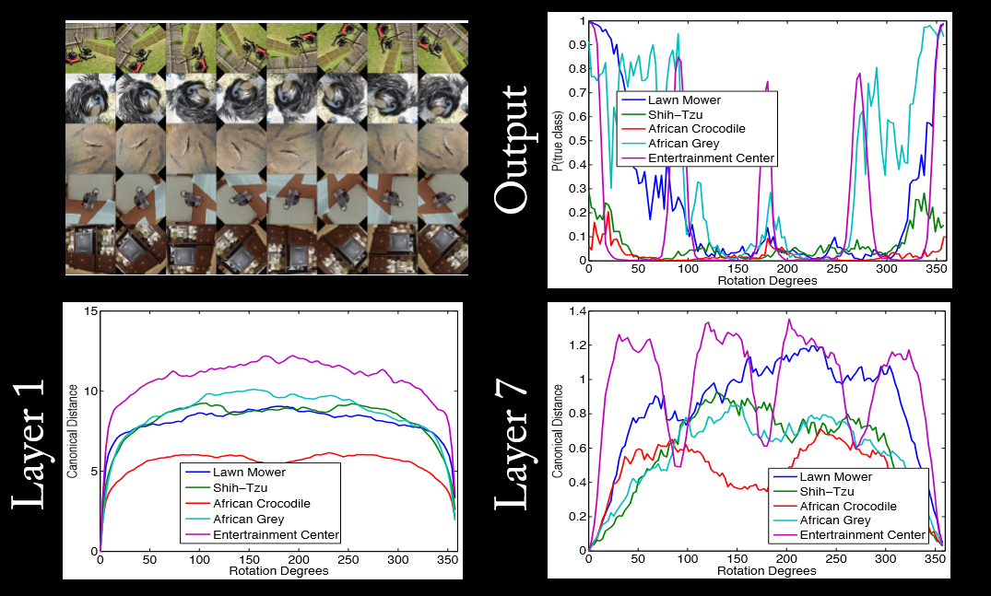
AlexNet: rotation invariance
[From Rob Fergus’ CIFAR 2016 tutorial]

Slide 53

GoogLeNet
Issue: multiscale nature of images
https://towardsdatascience.com/a-simple-guide-to-the-versions-of-the-inception-network-7fc52b863202
Larger kernel good for global features, and smaller kernel for local features.
Idea: have multiple different-size kernels at any given level.

Slide 54
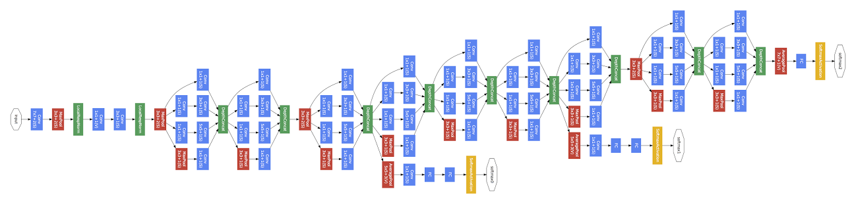
GoogLeNet
24-layer model that uses so-called inception module.
[Going Deep with Convolutions, Szegedy et al., arXiv:1409.4842, 2014]

Slide 55
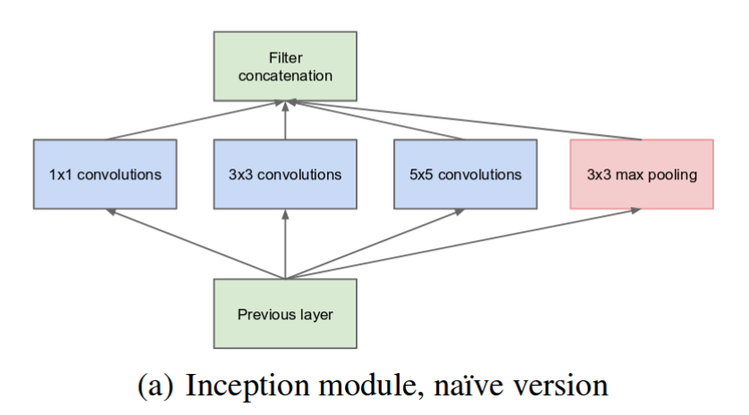
GoogLeNet
GoogLeNet inception module:
Multiple filter scales at each layer
number of filters
1x1
3x3
5x5
[Going Deep with Convolutions, Szegedy et al., arXiv:1409.4842, 2014]

Slide 56
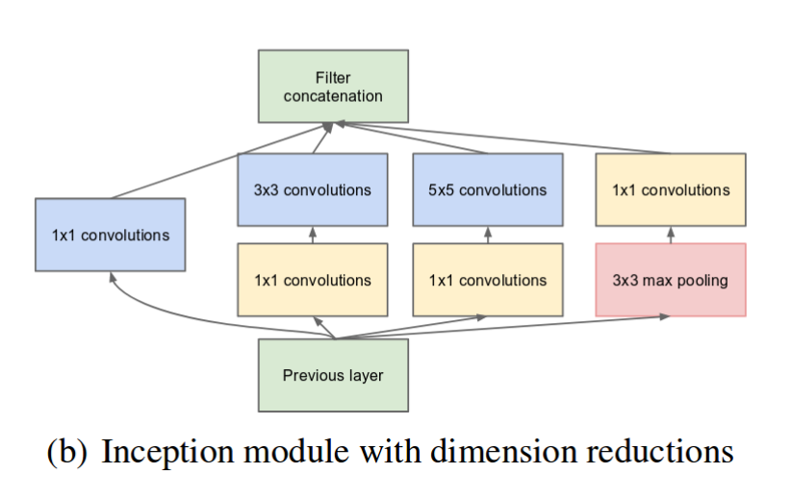
GoogLeNet
GoogLeNet inception module:
Multiple filter scales at each layer
Dimensionality reduction to keep computational requirements down
number of filters
1x1
3x3
5x5
[Going Deep with Convolutions, Szegedy et al., arXiv:1409.4842, 2014]

Slide 57
GoogLeNet
Width of inception modules ranges from 256 filters (in early modules) to 1024 in top inception modules.
Can remove fully connected layers on top completely
Number of parameters is reduced to 5 million
6.7% top-5 validation error on Imagnet
[Going Deep with Convolutions, Szegedy et al., arXiv:1409.4842, 2014]

Slide 58
Residual Networks
Really, really deep convnets do not train well, E.g. CIFAR10:
Reason: gradients involve multiplications of a # of matrices proportional to depth.
Vanishing/exploding gradients: gradients get very small/very large.
Key idea: introduce “identity shortcut” connection, skipping one or more layers.
Intuition: network can easily simulate shallower network (at initialization, F is not too far from 0 map), so performance should not degrade by going deeper.
[He, Zhang, Ren, Sun, CVPR 2016]

Slide 59
Residual Networks
Really, really deep convnets do not train well, E.g. CIFAR10:
Key idea: introduce “identity shortcut”
With ensembling, 3.57% top-5 test error on ImageNet
[He, Zhang, Ren, Sun, CVPR 2016]

Slide 60
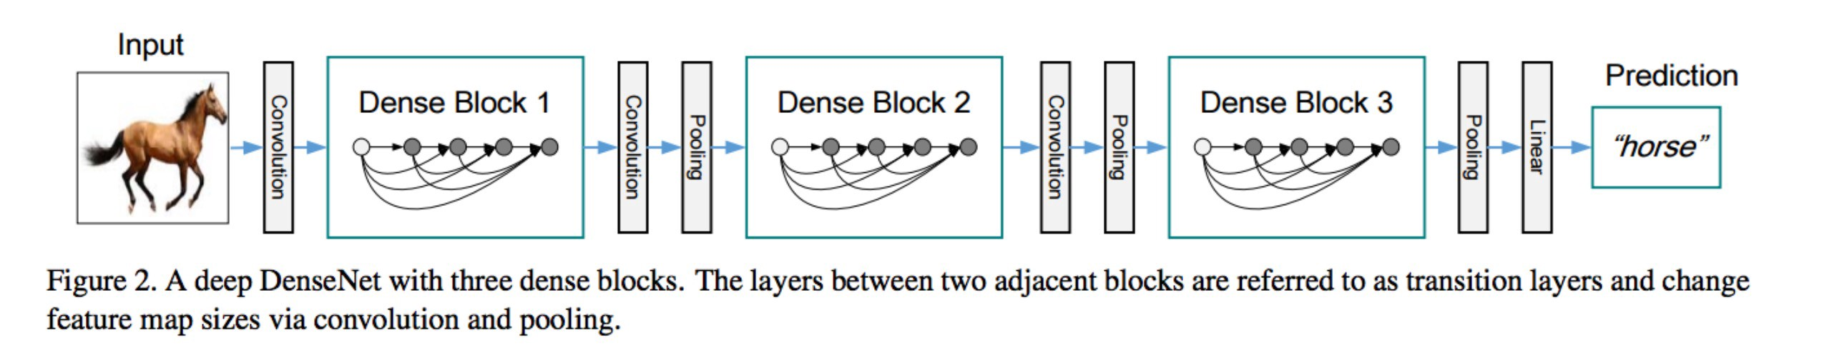


Dense Convolutional Networks
Information in ResNets is only carried implicitly, through addition.
Idea: explicitly forward output of layer to *all* future layers (by concatenation).
Intuition: helps vanishing gradients; encourage reuse features (& hence reduce parameter count);
Full architecture for Imagenet
[Huang, Liu, Weinberger, van der Maaten, CVPR 2017]

Slide 61

Debugging hints
Check gradients numerically by finite differences
Visualize features (feature maps need to be uncorrelated) and have high variance
Good training: hidden units are sparse across samples
[From Marc'Aurelio Ranzato, CVPR 2014 tutorial]

Slide 62

Debugging hints
Check gradients numerically by finite differences
Visualize features (feature maps need to be uncorrelated) and have high variance
Bad training: many hidden units ignore the input and/or
exhibit strong correlations
[From Marc'Aurelio Ranzato, CVPR 2014 tutorial]

Slide 63

Debugging hints
Check gradients numerically by finite differences
Visualize features (feature maps need to be uncorrelated) and have high variance
Visualize parameters: learned features should exhibit structure and should be uncorrelated and are uncorrelated
[From Marc'Aurelio Ranzato, CVPR 2014 tutorial]

Slide 64
Debugging hints
Check gradients numerically by finite differences
Visualize features (feature maps need to be uncorrelated) and have high variance
Visualize parameters: learned features should exhibit structure and should be uncorrelated and are uncorrelated
Measure error on both training and validation set
Test on a small subset of the data and check the error → 0.
[From Marc'Aurelio Ranzato, CVPR 2014 tutorial]

Slide 65
When it does not work
Training diverges:
Learning rate may be too large → decrease learning rate
Backprop is buggy → numerical gradient checking
Parameters collapse / loss is minimized but accuracy is low
Check loss function: is it appropriate for the task you want to solve?
Does it have degenerate solutions?
Network is underperforming
Compute flops and nr. params. → if too small, make net larger
Visualize hidden units/params → fix optimization
Network is too slow
GPU, distrib. framework, make net smaller
[From Marc'Aurelio Ranzato, CVPR 2014 tutorial]

